Slide 1
The Persian Wars
Greece’s Finest Hours

Slide 2
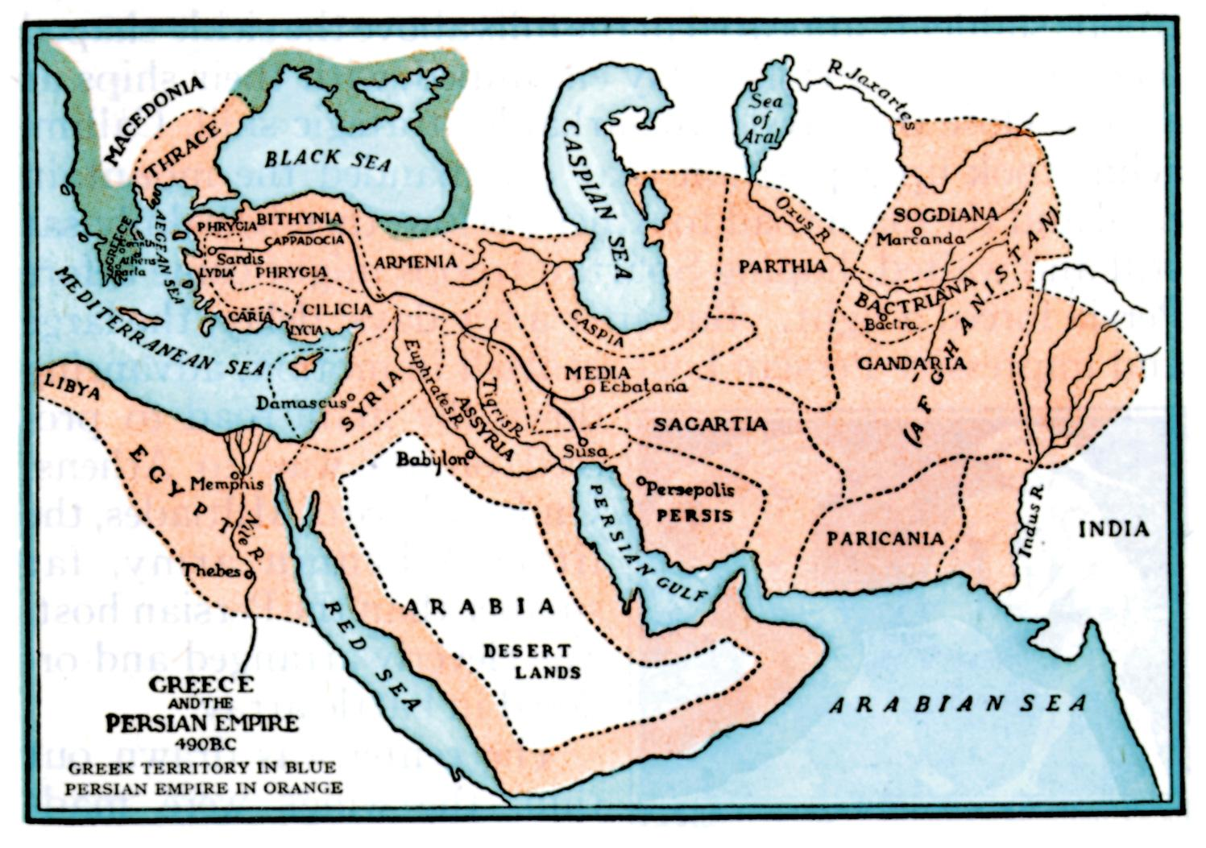
Where is Persia?

Slide 3
Why Fight?
Greeks had been settling on the west coast of Asia Minor (Persia)
Persia conquered these colonies
In 499 B.C. Greeks in these colonies revolted against Persian rule (they were used to ruling themselves—democracy)
Athens sent troops to support the revolt

Slide 4
Crushing the Revolt
Emperor Darius of Persia crushed the revolt rather quickly
He decided to punish Athens for helping the colonies
After training for a few years Darius sent troops to invade Greece
Sailed on to the Bay of Marathon

Slide 5
The Battle of Marathon
Athens asked Sparta to help, but Spartan troops would not arrive for 9 days (they were in the middle of religious festivals)
Other jealous city-states decided not to help Athens against the Persian Empire
So Athens took on the mighty Persian Empire by themselves

Slide 6
A Serious Mismatch
Persian troops—100,000
Athenian troops—20,000
Did Athens really have any hope against these odds?

Slide 7
Victory
The Athenian army was well-trained and did not break formation as they charged the Persian lines
The organized charge surprised the large but scattered (and poorly organized) Persian army
The Persian soldiers turned and ran from the oncoming Athenians

Slide 8
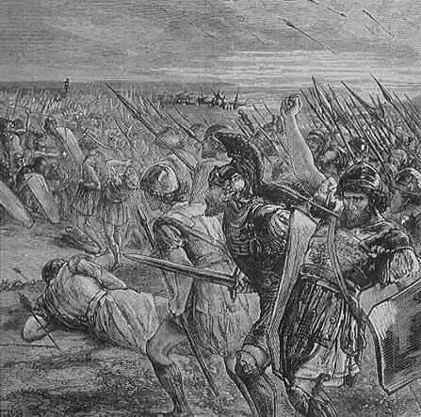

Slide 9
A Slaughter
The Athenian army almost drove the Persians back to the sea
Final tally
Persians—6, 400 dead
Athens—192 dead
Darius returned to Persia never to return

Slide 10
Connection to the Past
The modern marathon has its roots in the Battle of Marathon
A Greek soldier, Phidippides, ran from Marathon to Athens (26 miles) to tell the Athenians of the Greek victory and to warn them that the Persians may try to attack
Phidippides died from exhaustion after delivering his message
Today’s 26 mile marathon races remember his heroic act of martyrdom

Slide 11
Back for Revenge
The Persian Emperor Darius never returned, but his son Emperor Xerxes did
In 480 B.C. the Persians returned to Greece
They brought even more men this time around

Slide 12
The Battle of Thermopylae
Persians met a force of Greeks at Thermopylae
This was a small mountain pass that controlled access to all of Greece
For two days 7,000 Greeks held the Persians back, but…

Slide 13
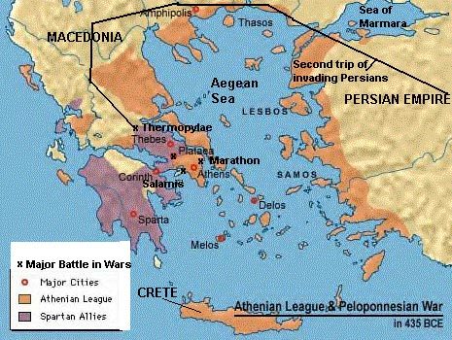

Slide 14
The Downfall
A Greek traitor showed the Persians a secret passageway
This allowed the Persians to sneak up from behind and attack the Greeks
Most of the Greek defenders ran away

Slide 15
A Heroic Act
About 300 Spartans stayed behind and fought to their deaths
This allowed the other Greeks to escape capture or certain death

Slide 16
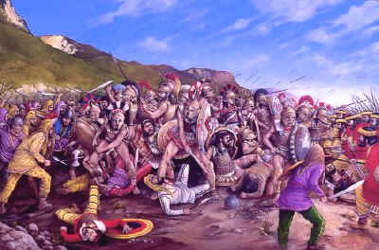

Slide 17
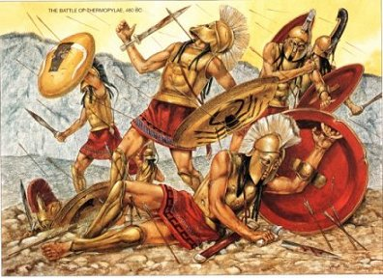

Slide 18
Here come the Persians
The Persians poured into Greece
They got their revenge by wreaking havoc
They even burned Athens to the ground
What were the Greeks to do?

Slide 19
The Battle of Salamis
As their city-state burned the Athenian people and the army escaped to the island of Salamis
The Persians were quick to follow the retreating Greeks to Salamis

Slide 20
Those Clever Athenians
The Greeks ships first sailed from shore like they were fleeing the island
They then turned quickly around and began ramming the Persian ships
Before the Persians knew what had happened half of their fleet was on the ocean floor
The Persians once again retreated back to Persia

Slide 21
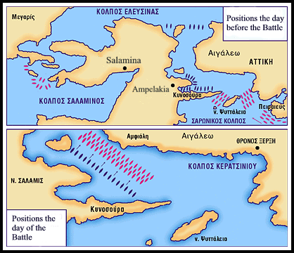

Slide 22
The Final Battle
The Battle of Plataea
The Greeks and Persians at equal strength
Athens and Sparta fought side by side
Greek military superiority won out and Persia retreated for good

Slide 23
How did the Greeks do it?
Three reasons
Inherent advantage of the defender
They were better soldiers
They used the element of surprise

Slide 24
This powerpoint was kindly donated to www.worldofteaching.com
http://www.worldofteaching.com is home to over a thousand powerpoints submitted by teachers. This is a completely free site and requires no registration. Please visit and I hope it will help in your teaching.

